Slide 1
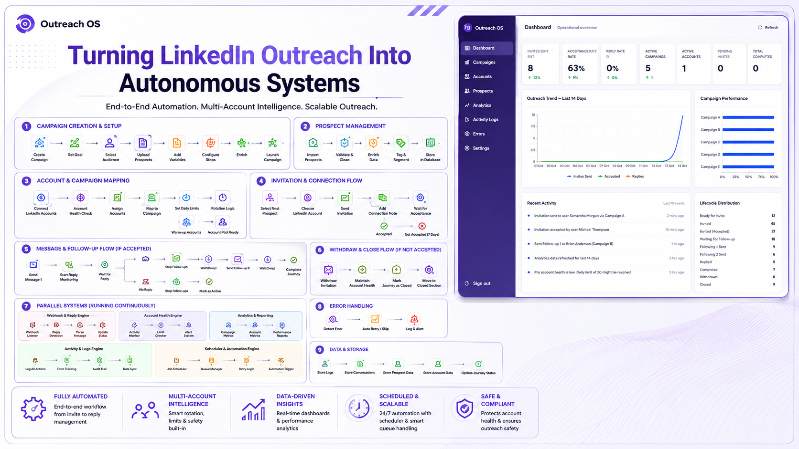

67%
45%

Slide 2
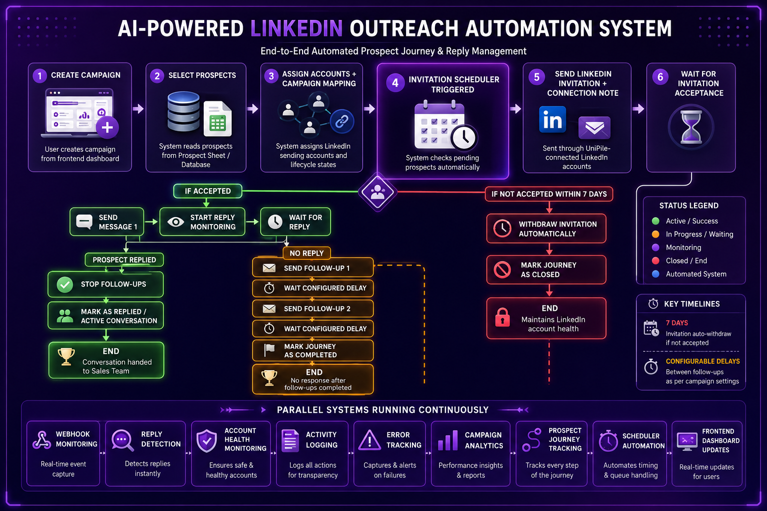
67%
45%

Slide 3

67%
45%

